Slide 1

Smart Retrofitting of Legacy Machines: Towards Industry 4.0
AEAR
Lab
ARGHYA BISWAS KAMRUL HASAN
Assis
Department of Electrical & Electronic Engineering
Chittagong University of Engineering & Technology
Chittagong, Bangladesh
March 31, 2022

Slide 2
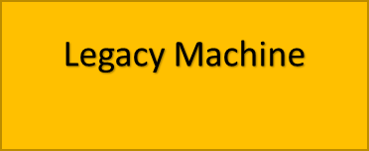
Retrofitting
Renovating legacy machines by re-equipping them with modern technologies.
Cyber Physical Production Systems-
CPPS Retrofitting
Virtual Machine
Physical Layer
Cyber Layer
Why:
To enhance productivity, the cost and time to replace older machines will be unsustainable.
Due to absence of collaboration between the machines, it takes a lot of time for machines to be controlled by a human operator.

Slide 3
Factors of Retrofitting
IoT Services
Cyber Physical System (CPS)
AIMS and BENEFITS
FINANCIAL SOCIAL ECOLOGICAL
>Increases productivity by ensuring > Guarantees improved quality and > Reduces latency of machines and
secured and faster connectivity between machines safety of products thus power loss
>Lower maintenance and operation cost by enabling > Delighted customer experience > Leads to lower environmental
cloud-based remote control pollution

Slide 4
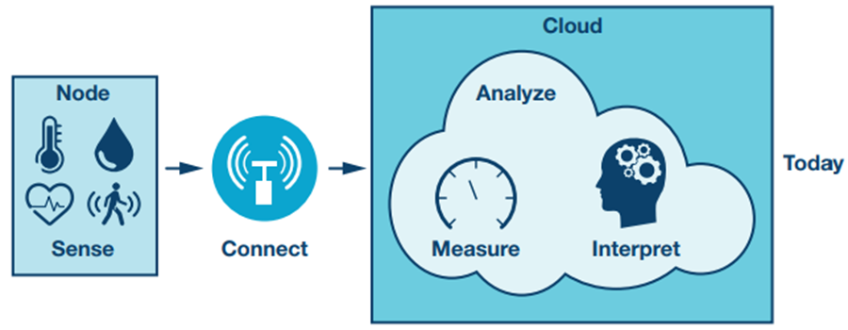

Methodology
© Analog Devices, Inc

Slide 5
Methodology
Three segments of CPPS Retrofitting:
Application
Monitoring: Device Name,
Status, Values
Cloud Component: AWS Cloud
Ubuntu, Intel Cloud
Remote Access
Infrastructure
Connecting Microprocessors
(Raspberry Pi, Arduino etc.)
Connecting IoT devices
(accelerometers, radar, camera, etc.)
Connecting PLCs
(Siemens S7-200, Delta etc.)
Communication
Network Component: Wifi, Profinet, Ethernet, Profibus, Modbus TCP/IP, MQTT
OPC Component: OPC UA, OPC UA Server, OPC UA Client
SDN Component: Open, scalable, programmable, highly available

Slide 6

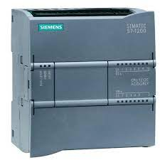

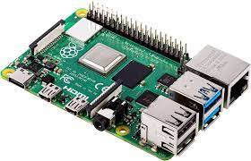







Communication strategy in CPPS Retrofitting
PLC 1
Server
Pub
OPC
UA
Sub
OPC
UA
Pub
PLC
2
Sub
Client
Client
Pub
PLC
3
Publisher
Sub
SIEMENS-S7200 and R-Pi
With OPC UA Server
Legacy Machine

Slide 7
Challenges in Implementing CPPS Retrofitting:
Creating a standardized retrofitting process for different legacy machines.
Companies where craftsmanship still dominates.
Companies with very poor level of automation.
Training the existing employees with relevant technical knowledge.

Slide 8
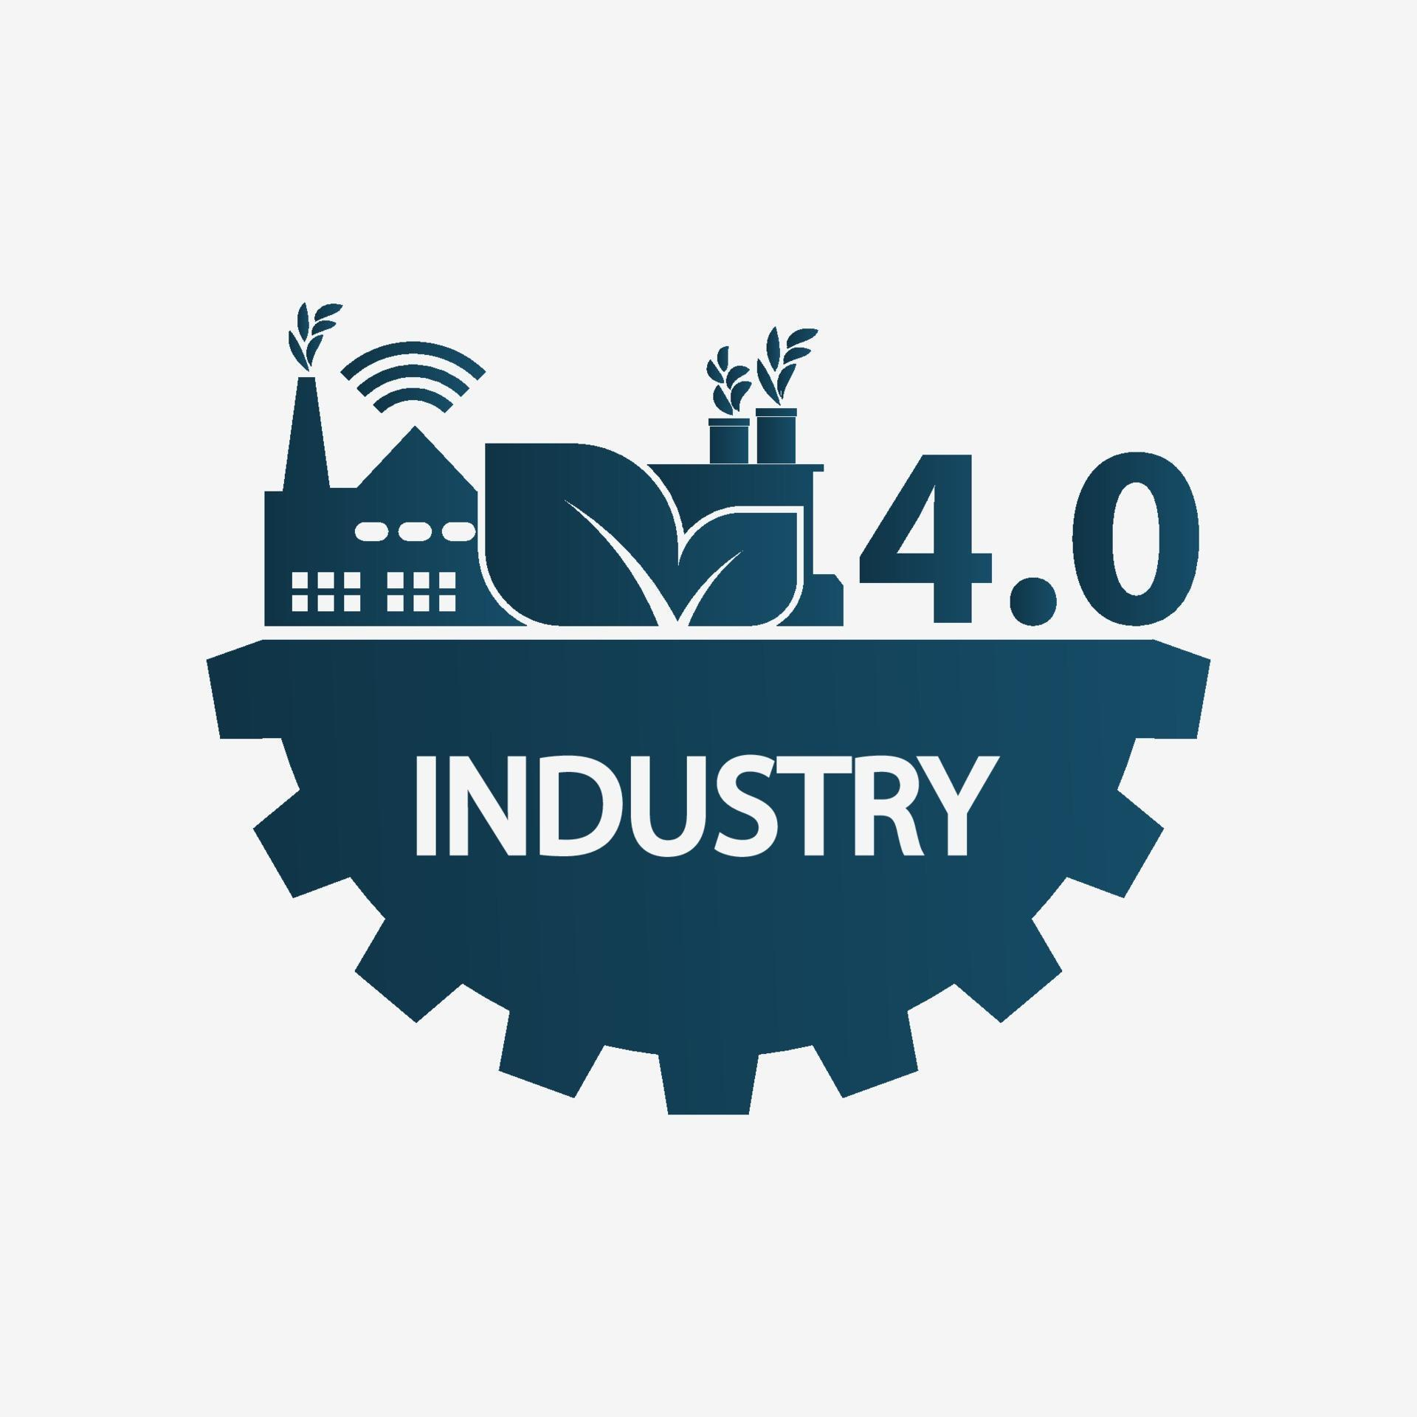
AEAR
Lab
THANK YOU

